Slide 1
Bus Tracking System
Android Application

Slide 2
About us
Group Name: Android Developers
Group Members:
Anurag Chitnis
Satyanarayana Chivukula
Nitesh Kumar Sharma
Gill Wasserman

Slide 3
Overview
Project Description, Motivation
Major functions, Development Environment
Team member responsibilities
Project directory structure
Project schedule – PERT and Gantt chart, MOM
Risk Management

Slide 4
Project Description
Motivation – Current UNT bus system, problems
Major Functions
tracking of buses and e-ride using GPS
Rout information and schedule on google map
Development Environment
Android Studio
GitHub

Slide 5
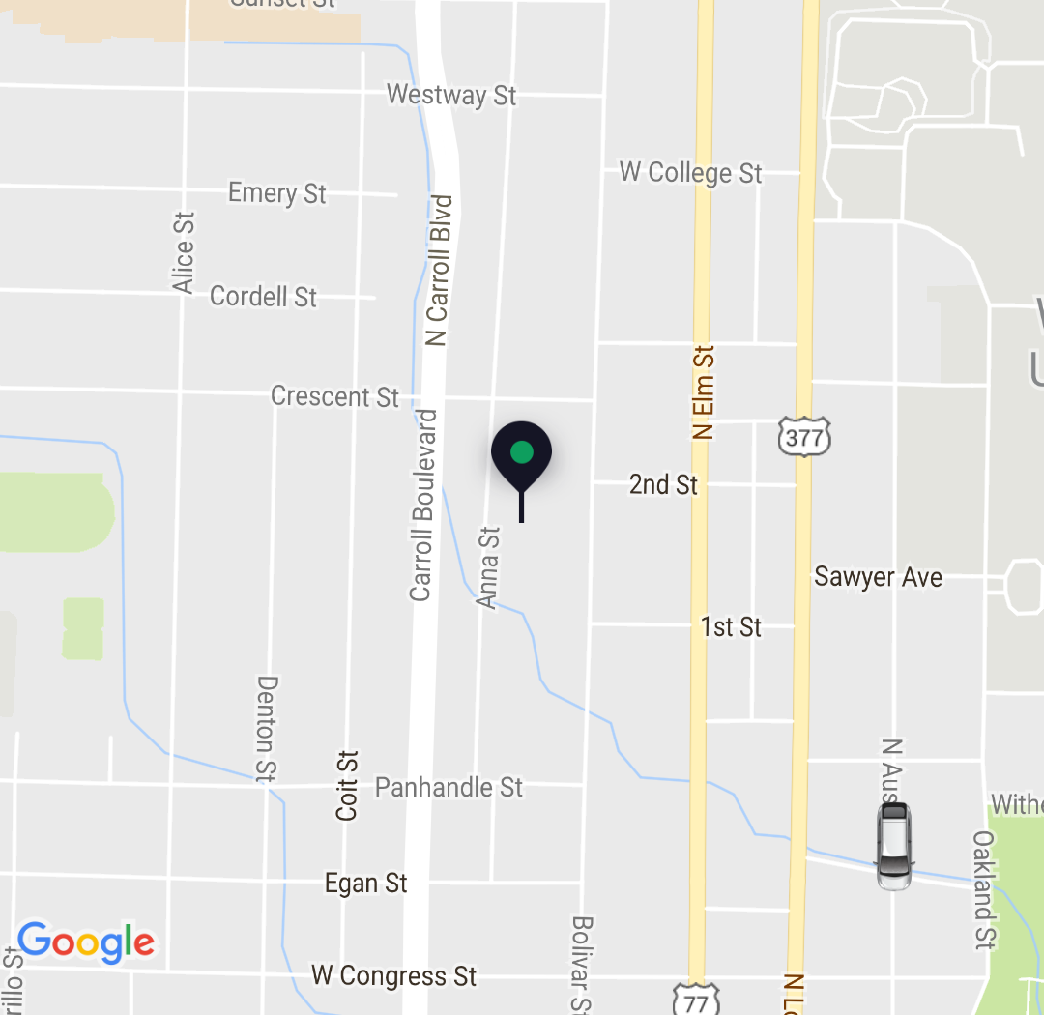
Sample user interface
Showing the bus and user location on the map

Slide 6
Project schedule
PERT Chart
Program Evaluation and Review Technique
Enable the manager to monitor and control project progress and detect deviations
Gantt Chart
Tracking Technique
helps understand which activities can be performed concurrently

Slide 7
PERT CHART

Slide 8
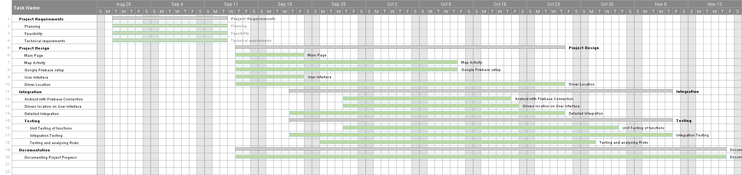
Gantt Chart

Slide 9
Minutes of meeting
Every Tuesday and Thursdays from 10:40 AM to 11:20 AM
All the four team members
Updated in GitHub on every MOM by every team member
Things Discussed
Project Requirements, feasibility, scope and technical requirements
Responsibilities, contribution and workload for each team member
Risk Management and contingency plans

Slide 10
Application architecture
There are 3 main entities involved in this application
Users’ App – acts as the receiver
Drivers’ App – acts as the GPS tracking device. This entity replaces the traditional GPS device.
Firebase – common real time database.
Location tracking is done real time taking advantage of Firebase real time database.

Slide 11
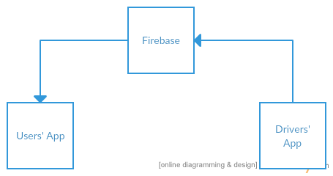
Application Architecture (cont..)
Core Entities Interaction

Slide 12
Application architecture (cont..)
Technical Terms
Each Route is given an Identification, say R1 – Discovery Park
Each Bus of the route is given another Identification, say B1
Assumption, each bus has one drivers’ app.
Lat – Latitude
Lon – Longitude.

Slide 13
Users’ App
It has 3 features or activities.
Track the Bus – opens the Bus tracking activity
Pulls lat, and lon from firebase in real time.
Parking Maps – opens the static map localities of UNT.
Bus Schedule – opens the bus route and timings activity which is static.

Slide 14
Map Activity
Bus route is highlighted with a color marked of the specific bus route.
Bus stops of the route are marked using static markers.
User’s location is tracked using google location API, to show the moving user towards or away from the bustop.

Slide 15
Drivers’ App & Firebase
It has only one activity that shares/ uploads the driver’s current lat and lon to the firebase.
Firebase is a google hosted application that works in collaboration with Android App, actually is hosts a service that interacts online table that holds lat and long each bus.

Slide 16
Risk Management
Inexperience with the Android platform
Use of newer technology with Firebase platform
Necessary to establish working relationship with UNT transportation department
Must have user’s trust in reliability
App has small margin for error for scheduling
Time constraints could force changes to desired features and limit testing.

Slide 17
Risk management
Assign code responsibilities based on experience
Assign extra team member to Firebase setup and initial integration with Android
Design app to be applied to any university, rather than relying on a single transportation department.
Keep features and design simple and straight forward
Lower priority for non-required features
Leave plenty of time for testing core features
Simple UI, user should require minimal instructions for use

Slide 18
Thank You!!!

